Slide 1

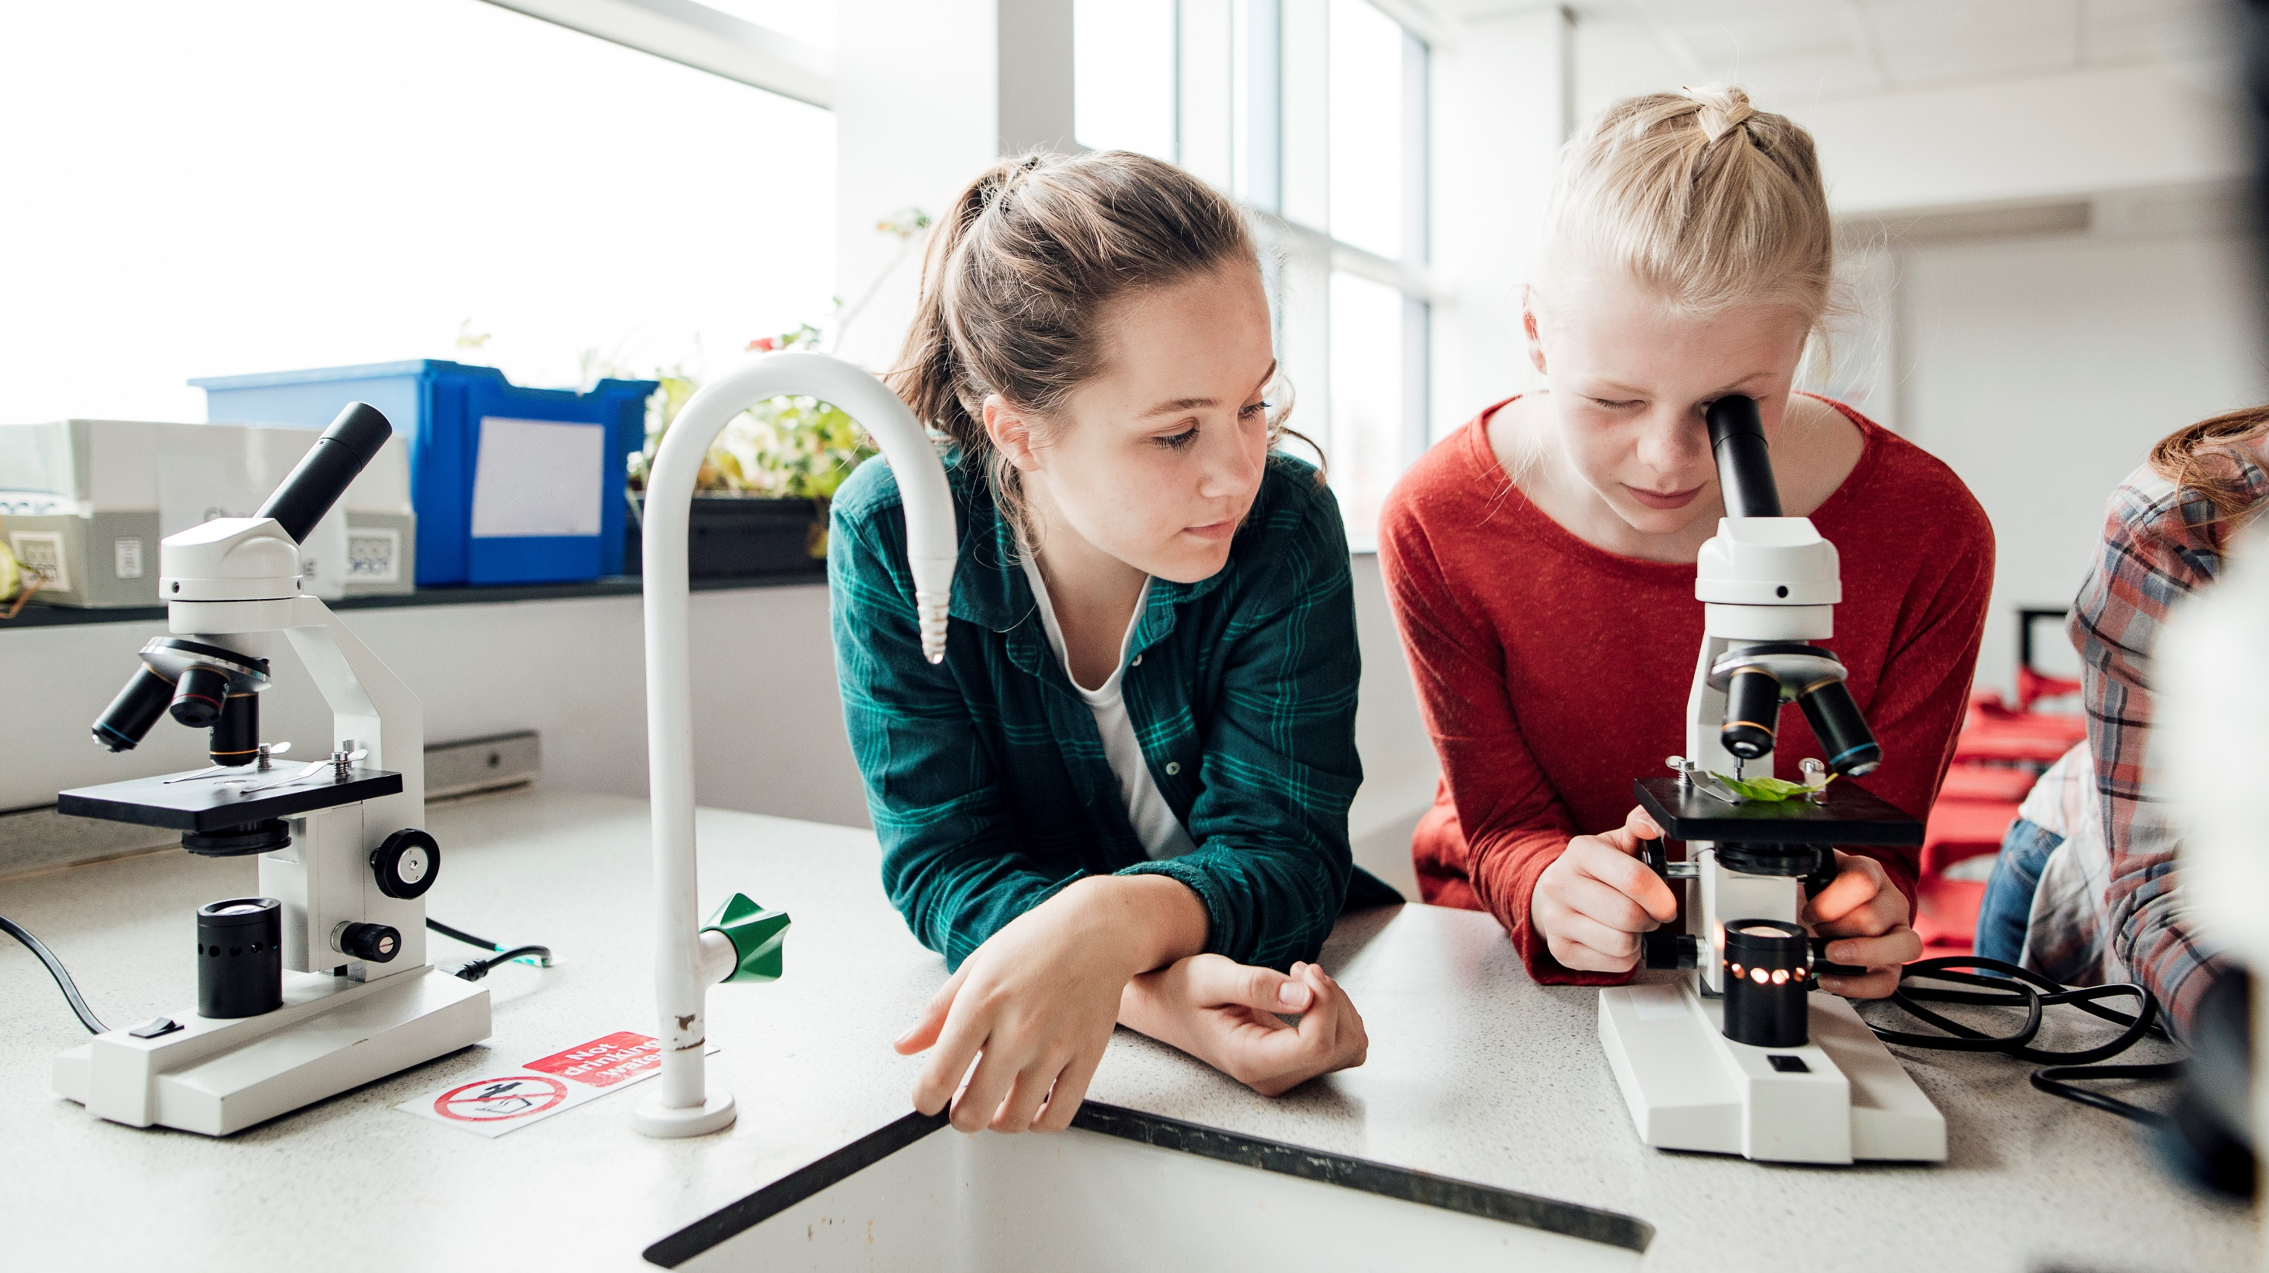
Equitable Learning Environments Frank Jamison National University April 21, 2024

Slide 2

TPE 2: Creating and Maintaining Effective Environments for Student Learning
This TPE emphasizes the strategies involved in establishing and maintaining productive classroom environments that facilitate learning for all students.
Level 1: Minimal connection between lesson plans and students' prior knowledge. Instructional strategies and adaptations lack a clear rationale or connection to students’ needs, potentially leaving students disengaged or unsupported.
Level 2: Some attempts are made to engage students using basic adaptations, but these efforts may not fully align with students' needs or leverage their strengths, leading to only partial engagement and support.
Level 3: Clear connection between instructional strategies and students’ prior knowledge and experiences. Plans include adaptations that support diverse learning needs, effectively engaging most students.
Level 4: Detailed planning includes diverse and inclusive strategies that build on each student’s strengths and needs. Instruction is adaptive and responsive, promoting deeper student engagement and support.
Level 5: Advanced use of instructional strategies based on Universal Design for Learning (UDL) principles, ensuring all students are fully engaged and supported through highly flexible and inclusive teaching methods.

Slide 3

TPE 4: Planning Instruction and Designing Learning Experiences for All Students
This TPE focuses on the design and execution of instructional plans that address students’ diverse learning needs.
Level 1: Limited or no consideration of how lesson planning addresses the diverse needs of students. Plans may be rigid or inappropriate, potentially excluding some students from effective learning experiences.
Level 2: Some consideration of student diversity in planning, but the strategies may not be sufficiently tailored or effective, leading to learning experiences that do not fully engage all students.
Level 3: Plans are informed by a strong understanding of student diversity, including varied cultural, linguistic, and learning needs. Instructional strategies are appropriate and effective for most students.
Level 4: In-depth, culturally responsive teaching strategies are integrated into planning. Plans are highly tailored to individual student profiles, promoting enriched and meaningful learning experiences.
Level 5: Expert application of UDL principles in lesson planning, creating an exceptionally flexible and inclusive learning environment that adapts to the evolving needs of every student and ensures optimal engagement and learning outcomes.

Slide 4


TPE 2 Level Comparisons
Level 1 to Level 2
Progresses from no engagement strategies or adaptations for student diversity to minimal and often ineffective attempts to engage and support all students (CalStateTEACH Program, 2019a).
Level 2 to Level 3
Advances from basic and partially effective engagement strategies to more thoughtful and effective adaptations that clearly support diverse learning need (CalStateTEACH Program, 2019a).
Level 3 to Level 4
Moves from effective engagement strategies to more detailed and adaptive approaches that are tailored to individual student profiles and needs (California Commission on Teacher Credentialing, 2023).
Level 4 to Level 5
Shifts from tailored engagement strategies to a holistic use of UDL principles, ensuring all students are fully engaged and supported through highly flexible and inclusive teaching methods (California Commission on Teacher Credentialing, 2023).

Slide 5


TPE 4 Level Comparisons
Level 1 to Level 2
Improves from limited consideration of how lesson planning meets diverse needs to some planning that considers student diversity, although often insufficient (CalStateTEACH Program, 2019).
Level 2 to Level 3
Develops from basic consideration of diversity to more comprehensive planning that includes appropriate and effective instructional strategies for a diverse student body (CalStateTEACH Program, 2019).
Level 3 to Level 4
Enhances from general effective planning to in-depth, culturally responsive strategies that are highly tailored to individual learning needs and cultural backgrounds (California Commission on Teacher Credentialing, 2023).
Level 4 to Level 5
Elevates from culturally responsive and tailored instruction to the comprehensive integration of UDL principles, creating an exceptionally inclusive learning environment that adapts to the evolving needs of every student (California Commission on Teacher Credentialing, 2023).

Slide 6




Science in education Promotes
Research
Communication
Curiosity

Slide 7
TPE 2 Reflection
In my tutoring sessions, I primarily focus on completing tasks and covering content without fully engaging or supporting the individual learning needs of my students. At Level 1, my approach often lacks adaptation or connection to the diverse needs and backgrounds of the students I work with. For instance, I might provide the same explanation and practice exercises to all students regardless of their prior knowledge or learning styles.
This level reflects my current practice because I tend to rely on a one-size-fits-all approach, which may not effectively engage or support all students. I've noticed that while some students can follow along, others struggle to stay engaged or understand the material, indicating that my strategies are not sufficiently tailored to meet each student's unique needs.

Slide 8
TPE 4 Reflection
Similarly, at Level 1 in TPE 4, my planning for tutoring sessions is quite basic and often does not consider the individual differences among my students. My session plans generally include a set of standard exercises and explanations that are used universally, without modifications to accommodate different learning abilities or interests. This approach can result in sessions that are not as effective as they could be because they fail to address the specific challenges or strengths of each student.
This level accurately reflects my tutoring practice as I often find myself unprepared to adjust my methods or materials to better suit the diverse academic levels or cultural backgrounds of my students. My sessions sometimes feel rigid and are not always responsive to student feedback or progress, suggesting a need for more flexible and thoughtful planning.

Slide 9

Moving Forward
To improve beyond Level 1 in both TPE 2 and TPE 4, I recognize the need to develop more personalized engagement strategies and plan my sessions with a greater focus on each student’s individual needs. This will involve actively seeking student feedback about what works best for them, researching different instructional techniques, and applying a more adaptive approach to tutoring. Additionally, I plan to invest time in learning about cultural responsiveness and inclusive teaching practices to better support my students’ diverse backgrounds.

Slide 10
promoting safe and equitable learning environments
Effective Instructional Practices
My Individual Goals
Differentiated Instruction: By tailoring learning activities to meet the varied needs of students, educators can ensure that each learner feels supported and valued. This approach helps students from different backgrounds and with different abilities to engage meaningfully with the content, promoting a sense of inclusion and equity.
Culturally Responsive Teaching: Integrating practices that acknowledge and respect students’ diverse cultural backgrounds enriches the learning experience and builds a welcoming classroom atmosphere. This approach encourages students to bring their whole selves to learning, fostering a safe environment where every student feels seen and respected.
Universal Design for Learning (UDL): Implementing UDL principles ensures that teaching methods, materials, and assessments are accessible to all students, regardless of their learning style, ability, or background. This inclusivity prevents marginalization and promotes fairness in educational opportunities.
Positive Behavior Support: Establishing clear expectations for behavior and using positive reinforcement to encourage compliance can create a predictable and safe learning environment. This stability helps students feel secure, allowing them to focus on learning.
Formative Assessment: Regularly assessing student understanding in a non-threatening way allows educators to adjust instruction responsively, ensuring all students can achieve learning objectives. This practice supports a culture of continuous improvement and success.
Professional Development: Committing to ongoing professional growth in areas like equity, inclusion, and teaching effectiveness will ensure that I am equipped to meet the diverse needs of my students. This commitment will lead to more effective instructional strategies and a deeper understanding of how to create supportive learning environments.
Advocacy for Students: Setting a goal to advocate for equitable resources and opportunities for all students helps to level the playing field, particularly for those from underserved communities. This advocacy is key in fostering an environment where all students have what they need to succeed.
Reflective Practice: Aiming to reflect on my teaching practice will help identify areas for improvement, particularly in how students are supported and engaged. Reflection will drive better understanding and appreciation of how diverse learning environments operate, leading to more thoughtful and inclusive practices.
Community Engagement: Engaging with families and community resources will enrich the learning environment by bringing in multiple perspectives and support networks. This helps build a holistic educational ecosystem that supports students’ varied needs both inside and outside the classroom.

Slide 11
References
California Commission on Teacher Credentialing. (2023). Performance Assessment Guide.
CalStateTEACH Program (Director). (2019a). Teaching to the TPEs: TPE 2. https://www.youtube.com/watch?v=8ctpR-fUwp8
CalStateTEACH Program (Director). (2019b). Teaching to the TPEs: TPE 4. https://www.youtube.com/watch?v=nIvRgv4CRwU

